Slide 1
National Hydrology Project (HP Phase 3)
WB Mission 1-15, Sept., 2015
Project Implementation Plan (PIP) Revision
Technical Session: Role and Responsibilities of Central Agencies
Central Water & Power Research Station

Slide 2
Central Water and Power Research Station (CWPRS)
CWPRS, established in 1916, is a premier hydraulic research institute in India, under Government of India Ministry of WR, RD & GR- a Central Agency
Hydrometeorology (5 Scientists)
Hydraulic Instrumentation (20 Scientists)
CWPRS Role under HP I- facilitator in R&D specialized studies, PDS jointly with State IAs, institutional strengthening – specialised hardware & Software, CMRT, Capacity Building
CWPRS Role under HP II- facilitator in R&D specialized studies, PDS jointly with State IAs, contributed in conceptualisation and customisation of DSS(P), institutional strengthening – specialised hardware & Software, Model Canal with SCADA, Capacity Building, General infrastructure

Slide 3
CWPRS Proposal for NHP 2015-2022
identified role for CWPRS-
a role of facilitator in R&D
providing technical expertise for HYDROMET instrumentation used for Water Level measurement, Velocity measurement, FCS, Communication systems, software development and training related to hydromet instruments so as to support the water resources management program of states
strengthening research facilities, infrastructure development- technical and general, capacity building
assistance in sustainable DSS technology development,
purpose driven studies involving special technical support within the overall framework of the Project.

Slide 4
CWPRS Proposal under NHP
Components:
A. Water Resources Data Acquisition System-
Setting up of HYDROMET instrumentation facilities for Water Level measurement, Velocity measurement, FCS, Communication systems, software development and undertake training related to hydromet instruments so as to support the water resources management program of States
Finalisation of specification for Hydromet Instruments and Technical bid evaluation for State IAs.
Extending technical guidance to State IAs in operational activities
Upgradation of Current Meter Rating Trolley
Purpose driven studies for Water Resources Development, Management and Planning through addressing vital issues such as Water Quality, ground water etc using recent techniques.
B. Water Resources Information System (WRIS)- NA

Slide 5
CWPRS Proposal under NHP
C. Water Resources Operation and Planning-
Purpose driven studies for Water Resources Development, Management and Planning using HP data relevant to implementing agencies addressing vital surface water issues such as Water availability, Drought, Ungauged basins etc based on the needs of the states.
D. WR Institutions Capacity Enhancement-
Infrastructure development- general and technical, Construction of Hydromet instrumentation Laboratory for training of Water Level measurement, Velocity measurement, Communication systems, software development, Computer laboratory to support State IAs; Upgradation and utilization of model canal with SCADA facility developed under HP-II, Electrical Installations, development of Audio-Video studio, Digitization of technical reports, purchase of vehicle, Officers Suites and Auditorium.
Strengthening specialized research facilities of CWPRS- Spillway model studies set up in complex hydrological scenario, Coastal Field data collection capability, Up-gradation of research and infrastructure facilities at Sediment Disposal Research Centre, Upgradation of Gravimetric and Volumetric Laboratory, procurement of Specialized IT hardware and Software etc for addressing various technical problems of water resources projects in India and providing optimal solutions, Capacity Building.
To extend requisite assistance in customization, implementation and sustenance of DSS(P) in various states; Capacity building measures for sustainable DSS (P) & DSS-RT.

Slide 6
Implementation Arrangements Overall Project Management
Coordinator [Name, Designation, Address and contact details including email ID] |  | The Director, CWPRS ,Khadakwasla Pune Tel: (020)24103500/3200, Fax: 24381004, e-mail: director@cwprs.gov.in
Nodal Office [Name, Designation, Address and contact details including email ID] |  | Shri R S Jagtap, Joint Director, CWPRS, Khadakwasla Pune PMU: Tel: (020)24103251, Fax: (020)24381004, e-mail: cwprshp3@gmail.com
Composition and Deployment of Full time Core Team [Number Of Technical/ Professional Positions]
Number Planned | Number Redeployed |  | Number filled On Deputation | Number Hired on Contract
60 | 60 |  | NIL | NIL

Slide 7
Implementation Arrangements
The execution of CWPRS NHP proposal has been broke up into two parts:
HydroMet Instrumentation Component
Finalisation of specification for Hydromet Instruments and Technical bid evaluation for State IAs.
Extending technical guidance to State IAs in operational activities of Hydromet instruments and training etc.
Establishment of state of the art Hydromet Instrumentation Laboratory at CWPRS
II. CWPRS institutional Strengthening, Overall Project Monitoring etc

Slide 8
Implementation Arrangements Organogram- HydroMet Instrumentation Component
Director, CWPRS
Project Coordinator
Dr (Mrs) V V Bhosekar, Sci-E
Team Leader
Finalisation of specification for Hydromet Instruments and Technical bid evaluation for State IAs
Committee of experts from CWPRS
Extending technical guidance to State IAs in operational activities by forming 5 teams
Kerala, Tamil Nadu, Puducherry, Karnataka, Andhra Pradesh, Telangana, Andaman & Nicobar, Lakshadweep
Jammu & Kashmir, Punjab, Uttarakhand, Haryana, Himachal Pradesh, Delhi, Chandigarh
Maharashtra , Gujarat, Rajasthan, Madhya Pradesh, Goa, Daman & Diu, Dadra & Nagar Haveli
Uttar Pradesh, Bihar, Chhattisgarh, Jharkhand, Orissa, West Bengal
Assam, Arunachal Pradesh, Sikkim, Tripura, Meghalaya, Nagaland, Manipur, Mizoram
Establishment of state of the art Hydromet Instrumentation Laboratory at CWPRS
Training facility for Water Level Measurement
Training facility for Communication System
Training facility for Velocity Measurement
SCADA Software Development, interface and Training Facility Laboratory
Setting up Full Climatic Station
Construction of Hydromet Instrumentation Laboratories
Nodal Officer PMU
Project Monitoring Unit
Joint Director

Slide 9
Implementation Arrangements Organogram- General and PMU, CWPRS
Project Coordinator
Director, CWPRS
Finance Office
Finance Officer
LA etc
All Budget and finance related issues
Project Monitoring Unit (PMU)
Nodal Officer
JD, Sc-C, Sc- B, ARO, RA
General project administration, Coordination and Liaison, Progress Monitoring
Technical Division
AD/ Sc-E
Sc.-D, Sc.-C, Sc.-B
ARO,RA
Responsible for complete execution of the approved technical proposal
Executive Engineer
(CIVIL) Office
EE(Civil)
Sc-B/ AE/ JE
Execution of approved Civil works, Goods, Consultancy etc

Slide 10
CWPRS institutional Strengthening, Capacity Building, PDS etc
Technical proposal | PARENT Division | Project Officers | Supervision AD/Sc-E/ JD
Upgradation of Current Meter Rating facility under HP – III | CMRT | Shri R.P. Gupta, Sc-D Mrs. H.R. Khandagale, Sc-B | Shri P.K.Goel Sc-E
PDS in collaboration with state implementing agencies | HMET/ other division | Dr. C. Ramesh, Sc-C Shri C. Srishailam, Sc-B Dr. Annapurna Patra, Sc-B | Shri R.S.Jagtap, JD / Sc-E
Training facility in DSS(P) | HMET | Dr. C. Ramesh, Sc-C Shri N. Vivekanandan, ARO | Shri R.S.Jagtap, JD
Water quality modelling of Mutha River reach flowing through Pune city and suburbs, Maharashtra | WQAM | Dr. S.P. Vaidya, Sc-D Shri K.K. Gupta, Sc-C | Shri R.S.Jagtap, JD
Water quality model studies for the assessment and prediction of water quality of Ujjani Reservoir, Maharashtra | WQAM | Dr. S.P. Vaidya, Sc-D Dr. V.M. Prabhakar, Sc-B | Shri R.S.Jagtap, JD

Slide 11
CWPRS institutional Strengthening, Capacity Building, PDS etc
Technical proposal | PARENT Division | Project Officers | Supervision AD/Sc-E/ JD
Estimation of groundwater potential of a region – Integrated Application of Geophysical and Hydrogeological techniques with RS-GIS | GP | Dr. C. Krishnaiah, Sc-D Mrs. Namita Karki, ARO | Shri R.S.Ramteke, AD
Creation and Management of Digital Documents at CWPRS | WAPIS | Dr. M. M. Rao, LIO Dr. D.T. Gaikwad, ALIO | Shri R.S.Ramteke, AD
Infrastructure development (Technical & General, Procurement, Training, R&M etc) and purchase of new vehicle | PMU/ HMET | Shri Srimant Kumar, RO ARO or RA | Shri R.S.Jagtap, JD
Enhancement of Costal Field Data Collection Capabilities for wave Parameters | CFI | Shri G.V.Ramana Rao,Sc-D Mrs. A.A.Sonavane, ARO | Shri M.D.Kudale Sc-E
Research facility for model studies of spillways to assess discharging capacity in complex hydrological scenario | SED | Dr. M.R. Bhajantri, Sc-D Shri R.R. Bhate, Sc-B Shri B.S. Sundarlal, Sc-B | Dr(Mrs) V. V. Bhosekar, Sc-E

Slide 12
CWPRS institutional Strengthening, Capacity Building, PDS etc
Technical proposal | PARENT Division | Project Officers | Supervision AD/Sc-E/ JD
Officer’s Suites | EE (CIVIL) | Executive engineer (Civil) Shri S Phulpagare, Sc.-B
Auditorium | EE (CIVIL) | Executive engineer (Civil) Shri S Phulpagare, Sc.-B
Infrastructure development of hydrometeorology group – IT hardware and software (MIKE FLOOD, MIKE-SHE, HYFRAN etc.) | HMET | Dr. C. Ramesh, Sc-C Shri I.I. Powale, Sc-B | Shri R.S.Jagtap, JD
Up-gradation of research and infrastructure facilities at Sediment Disposal Research Centre, CWPRS | SM | Mrs Neena Isaac, Sc-D Shri M.K. Verma, Sc-B Shri M.Z.Qamar,Sc- B | Dr(Mrs) V. V. Bhosekar, Sc-E
Upgradation of various Electrical Installations at CWPRS | ELECT. | Shri G C Sahoo,Sc-B Shri K.C. Biradar, Sc-B | Shri P.K.Goel Sc-E
DEVELOPING Audio-Video Recording Studio | PHOTO | Shri Abhay Godse, Photographer Shri Nilesh Shinde, LA | Sc –D, TC
Upgradation of Gravimetric and Volumetric calibration laboratories in HMC Division | HMC | Shri P M A Rahiman, Sci-D Dr K Kumar, Sci-B Shri T K Swain, Sci-B Shri S Ajay, Sci-B Shri S J Ghule, ARO Shri K U Farande, ARO | Shri P.K.Goel Sc-E

Slide 13
Participation by CWPRS Scientist
Sr No | Title | Organised/ sponsored by | Venue | Duration | Participants
1 | Training on Procurement Procedures & HP3 Preparation Mission Meeting | World Bank | WB, New Delhi | 20-21 Jan 2015 | 2
2 | Hydrology Project meeting at UP Irrigation Dept, Lucknow related to Hydromet instruments | Irrigation Department | Irrigation Department, Lucknow, UP | 19-21 Mar 2015 | 2
3 | Training Workshop on hydrometeorological network design and installation | World Bank & State Water Investigation Department, WB | Jal Shampad Bhavan, Kolkata | 6-11 Apr 2015 | 1
4 | Workshop on Dam automation and SCADA system | World Bank | WB, New Delhi | 16-17 Jun 2015 | 1
5 | Training on Hydro-met Design Under NHP | World Bank | HIPA, Shimla | 29 Jun- 3 Jul 2015 | 2
6 | World Bank Procurement Procedure | World bank | NWA, Pune | 27-31 Jul 2015 | 6

Slide 14
Procurement plan 2015-16
works |  | Goods |  | Expected Bid Opening Date | Expected Contract Award Date
item | Estimated Cost (INR Rs. In Lakh) | item | Estimated Cost (INR Rs. In Lakh)
Hydromet Instrumentation Laboratory | 400.00 | desktop computers and peripherals etc. | 19.00 | Jan. 2016 | Feb.2016
Officer’s Suits | 500.00 | Embedded Interface Units etc. | 4.80 | Jan. 2016 | Feb.2016
Auditorium | 500.00 | Under Grounding of LT transmission lines etc. | 2.20 | Jan. 2016 | Feb.2016

Slide 15
Procurement plan 2016-17
Works | Estimated Expenditure (INR Rs. In Lakh) | Goods | Estimated Expenditure (INR Rs. In Lakh) | Consultancy | Estimated Cost (INR Rs. In Lakh)
Hydromet Instrumentation Laboratory | 550.00 | desktop computers and peripherals etc. | 40.00 | Consultancy for Hydromet Laboratory | 45.00
Officer’s Suits | 100.00 | Resistivity Imaging System and Ground Probing Radar, water level sensors, SCADA Components | 200.00
Auditorium | 400.00 | ultrasonic current meter, Digital water level recorders, Pitot tubes etc, Wave data collection buoy procurement ,etc. | 150.00
Other Civil Works | 517.00 | Others | 59.65
Total | 1067.00 |  | 449.65 |  | 45.00

Slide 16
Disbursement Plan (INR Lakh)
Year | Quarter 1 | Quarter 2 | Quarter 3 | Quarter 4 | Total
2015-16 | --- | --- | --- | 52.63 | 52.63
2016-17 | 89.7 | 330.63 | 337.1 | 503.6 | 1163.40
Total | 89.7 | 330.63 | 337.1 | 503.6 | 1216.03

Slide 17
Capacity Building
Capacity Building Event | Coverage of Topics | For Whom | Duration | Batch size | By Whom | Year
Workshop on hydrometerological network design and installation | hydrometerological network design, instruments and installation | CWPRS instrumentation and Hydrology Scientist | 5 Days | 25 | World Bank Experts | Feb. 2016

Slide 18
CWPRS Proposal under NHP financial outlay
 | Project Component | (in Crore INR)
 |  | WB | Government | Total
A | Water Resources Data Acquisition System | 4.34 | 4.34 | 8.68
B | Water Resources Information System (WRIS) | 0.00 | 0.00 | 0.00
C | Water Resources Operation and Planning | 0.85 | 0.85 | 1.70
D | WR Institutions Capacity Enhancement | 22.92 | 22.92 | 45.84
TOTAL |  | 28.11 | 28.11 | 56.22

Slide 19
COMPONENT A: WATER RESOURCES DATA ACQUISITION SYSTEM
Type | Cost (INR lakh)
Training facility for Water Level Measurement | 140.00
Training facility for Communication System | 250.00
Training facility for Velocity Measurement | 140.00
SCADA Software Development, interface and Training Facility Laboratory | 86.79
Setting up Full Climatic Station | 19.00
Finalisation of specification for Hydromet Instruments and Technical bid evaluation for State IAs. | 20.00
Extending technical guidance to State IAs in operational activities of Hydromet instruments and training etc. | 100.00
Upgradation of Current Meter Rating facility under HP – III | 113.00
Grand Total | 868.79

Slide 20
Component C: Water Resources Operations and Planning 3.7 Purpose Driven Studies
Sl no | PDS Topic | Division responsible for carrying out | Anticipated benefits With Costs (Rs. In Lakh)
1 | PDS in collaboration with state implementing agencies | HMET | 35.00
2 | Water quality modelling of Mutha River reach flowing through Pune city and suburbs, Maharashtra | WQAM | 22.20
3 | Water quality model studies for the assessment and prediction of water quality of Ujjani Reservoir, Maharashtra | WQAM | 29.00
4 | Estimation of groundwater potential of a region – Integrated Application of Geophysical and Hydrogeological techniques with RS-GIS | GP | 83.00
 | Total |  | 169.20

Slide 21
COMPONENT D: WR INSTITUTIONS CAPACITY ENHANCEMENT 3.7.1 Component D:Water Resources Institutions and Capacity Building
Sr No | Activity | Division responsible for carrying out | Budgetary Cost (Rs Lakhs)
1 | Creation and Management of Digital Documents at CWPRS | WAPIS | 21.12
2 | Utilisation of Model Canal with SCADA system facility developed under HP-II for Capacity building, Basic Research and any up gradation | HI | 20.00
3 | Infrastructure development (Technical & General, Procurement, Training, R&M etc) and purchase of new vehicle | PMU /HMET | 84.05
4 | Enhancement of Costal Field Data Collection Capabilities for wave Parameters | CFI | 160.00
5 | Research facility for model studies of spillways to assess discharging capacity in complex hydrological scenario | SED | 1015.0
6 | Hydromet Instrumentation Laboratory | EE(CIVIL) / HI | 600.00
7 | Officer’s Suites | EE(CIVIL) | 850.00
8 | Auditorium | EE(CIVIL) | 995.00
9 | Training facility in DSS(P) | HMET | 11.00
10 | Infrastructure development of hydrometeorology group – IT hardware and software (MIKE FLOOD, MIKE-SHE, HYFRAN etc.) | HMET | 37.00
11 | Up-gradation of research and infrastructure facilities at Sediment Disposal Research Centre, CWPRS | SM | 70.00
12 | Upgradation of various Electrical Installations at CWPRS | ELECT. | 95.00
13 | DEVELOPING Audio-Video Recording Studio | PHOTO | 30.0
14 | Upgradation of Gravimetric and Volumetric calibration laboratories in HMC Division | HMC | 595.85
 | Total |  | 4584.02

Slide 22
Project Success Indicators/ outcomes to measure the Success of the project
Construction of state of the art HYDROMET Instrumentation Laboratory for Water Level measurement, Velocity measurement, FCS, Communication systems, software development and development of Computer laboratory for training purposes.
Finalisation of specification for Hydromet Instruments and Technical bid evaluation for State IAs.
Extending technical guidance to State IAs in operational activities of Hydromet instruments and training, etc.
Jointly carry out Specific R&D/ Purpose driven studies in hydrology, Water Resources Development, Management and Planning addressing surface and ground water, Water Quality issues as per States need.
a. Strengthening specialized research facilities of CWPRS- Upgradation of Current Meter Rating Trolley, Upgradation and utilization of model canal with SCADA facility developed under HP-II, Spillway model studies set up in complex hydrological scenario, Coastal Field data collection capability, Up-gradation of research and infrastructure facilities at Sediment Disposal Research Centre, Upgradation of Gravimetric and Volumetric Laboratory, and procurement of Specialized IT hardware and Software etc for addressing various technical problems of water resources projects.
b. Infrastructure development- Officers Suites and Auditorium, Electrical Installations, Capacity Building, development of Audio-Video studio, Digitization of technical reports, Purchase of vehicle etc.

Slide 23
Hydromet Instrumentation Component
Technical Details

Slide 24
HYDROMET INSTRUMENTATION FACILITIES FOR WATER RESOURCES MANAGEMENT PROGRAM
Under Hydrology Project III, it is proposed to manage water resources of entire country through integrated approach using state of art technology.
It is therefore essential to modernize nationwide data, information and knowledge support by each implementing agency using latest Hydro-Met instrumentation.

Slide 25
HYDROMET INSTRUMENTATION COMPONENT
ROLE OF CWPRS
Finalisation of specifications for Hydro-Met Instruments and Technical bid evaluation for State IAs.
Extending technical guidance to State IAs in operational activities of Hydro-Met instruments and training
Establishment of state of the art Hydro-Met Instrumentation Training Laboratory at CWPRS

Slide 26
FINALISATION OF SPECIFICATION FOR HYDROMET INSTRUMENTS AND TECHNICAL BID EVALUATION
Committee of experts from CWPRS for finalisation of specifications for the Hydro-Met instruments and technical bid evaluation
1 | Dr. (Mrs.) V.V. Bhosekar, Sc-E: Chairman
2 | Shri S.D. Ranade, Sc-D : Member -Secretary
3 | Shri N.D. Atkekar, Sc-D : Member
4 | Shri P.R. Khatarkar, Sc-D : Member
5 | Dr. C. Ramesh, Sc-C : Member
6 | Procurement Officer of respective IA : Member

Slide 27
EXTENDING TECHNICAL GUIDANCE IN OPERATIONAL ACTIVITIES OF HYDROMET INSTRUMENTS AND TRAINING
Each state may recruit 4-5 officials having expertise in Hydro-Met Instrumentation so as to take care of their State independently.
CWPRS Instrumentation Scientists will then provide training, technical guidance and also will undertake field visits to help the State IAs in operational activities.
CWPRS will utilise the Hydro-Met Instrumentation laboratory that will be set up under NHP for providing technical support required by State IAs in training of Hydro-Met instruments.
CWPRS will form five teams to take care of all the State/ UT implementing agencies so as to cover whole of India.
Each team will consists of 3-4 Instrumentation and 1-2 Hydrology scientists. These teams will function from CWPRS, Pune.

Slide 28
REGIONWISE TEAMS COVERING VARIOUS STATES
Team No | Region | Implementing Agencies
1 | Southern | Kerala, Tamil Nadu, Puducherry, Karnataka, Andhra Pradesh, Telangana, Andaman & Nicobar, Lakshadweep
2 | Northern | Jammu & Kashmir, Punjab, Uttarakhand, Haryana, Himachal Pradesh, Delhi, Chandigarh
3 | Western and Central | Maharashtra , Gujarat, Rajasthan, Madhya Pradesh, Goa, Daman & Diu, Dadra & Nagar Haveli
4 | Eastern | Uttar Pradesh, Bihar, Chhattisgarh, Jharkhand, Orissa, West Bengal
5 | North Eastern | Assam, Arunachal Pradesh, Sikkim, Tripura, Meghalaya, Nagaland, Manipur, Mizoram

Slide 29
DETAILS OF HYDROMET INSTRUMENTATION FACILITY
Training facility for Water Level Measurement
Training facility for Communication Systems
Training facility for Velocity Measurement
Training facility for SCADA
Setting up Automatic Weather Station (AWS) for Training

Slide 30
HYDROMET INSTRUMENTATION LABORATORY AT CWPRS
Sr. No. | Training Facility | Sub Team
1 | Training facility for Water Level Measurement | Shri P.R. Khatarkar, Sc-D [Sub Team leader] Shri M.S. Bist, Sc-B Shri P. S. Solanki, Sc-B
2 | Training facility for Communication System | Shri S.D. Ranade, Sc-D [Sub Team leader] Ms Suneeta Jatwa, Sc-B Shri P.R. Dorle , Sc-B Mrs. Anuja Rajagopalan, Sc-B
3 | Training facility for Velocity Measurement | Dr N D Atkekar, Sc-D [Sub Team leader] Shri S. Ganguly, Sc-C Mrs Lata Gupta, Sc-B Mr V N Katte, Sc-B
4 | Training Facility for SCADA | Shri M. Selva Balan, Sc-D [Sub Team leader] Shri S.R. Swamy, Sc-C Shri S.B. Salunke, Sc-B Shri J.K. Singh, Sc-B
5 | Automatic Weather Station (AWS) | Dr. C. Ramesh, Sc-C [Sub Team leader] Shri I. I. Powale, Sc-B
6 | Construction of Hydro-Met Instrumentation Laboratories | Executive Engineer (Civil) [Sub Team leader] Shri Sunil Phulpagare, Sc-B

Slide 31
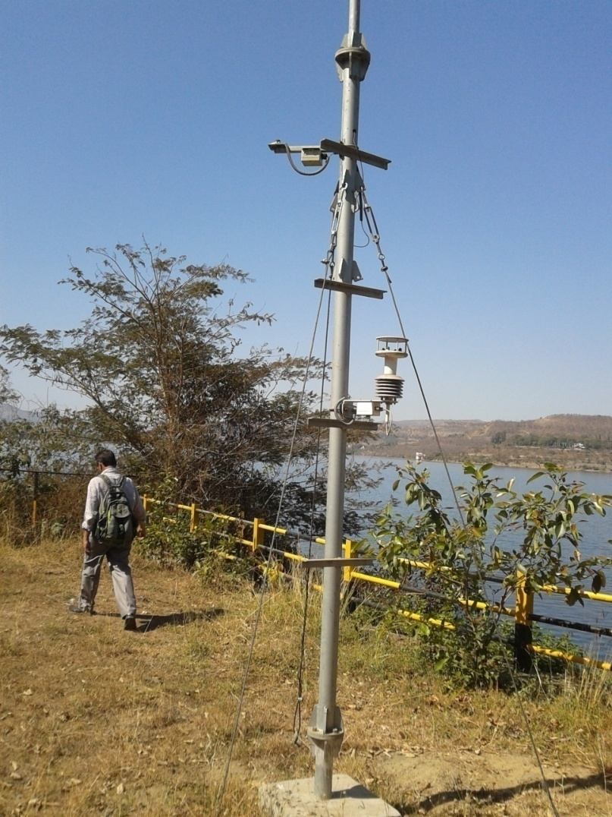
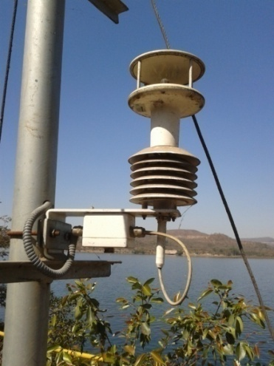
SETTING UP OF AWS
PARAMETERS
Air Temperature
Relative Humidity
Rainfall
Wind Speed
Wind Direction
Solar Radiation
Atmospheric Pressure
Automatic Weather Stations Provide an Unbiased, Uninterrupted Weather Data in User Friendly Mode
AWS will be Used for Training apart from Recording Weather Data at CWPRS

Slide 32
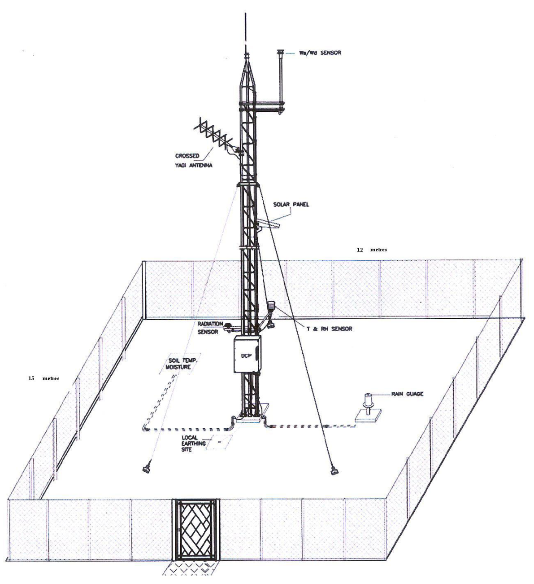
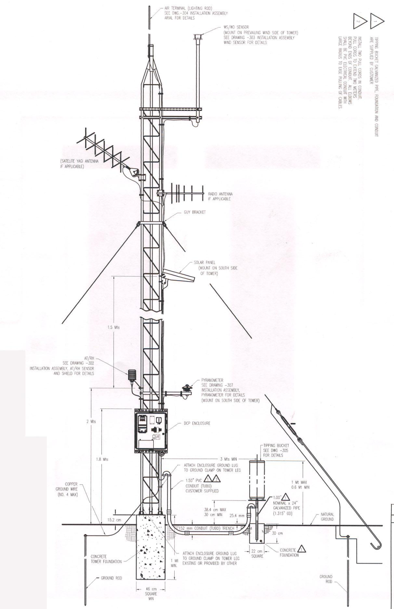
SCHEMATIC VIEW OF AWS SITE

Slide 33
DATA ACQUISITION SYSTEM
System shall have an integrated microprocessor based data acquisition and storage system
System shall automatically collect the observations from attached sensors, process the same and store them into its memory.
The number of analog/digital/ SDI channels in the data logger must be compatible to the sensors being supplied.
Providing necessary electrical power to the sensors
System shall have provision to easily include and change the Unique station identification code, Time of observation and Sensor identification.
System should be stand-alone
The stored data shall be retrievable via serial port to a PC/laptop
System shall have a weather-proof housing

Slide 34
SENSOR SPECIFICATIONS
AIR TEMPERATURE
a) Range | -40°C to +60°C
b) Accuracy | 0.2 °C or better
c) Resolution | 0.1°C
d) Sensor Type | Resistance type
e) Response Ti | 10 sec. or better
RELATIVE HUMIDITY SENSOR
a) Range | 0 to 100% RH
b) Accuracy | ±3% or better
c) Resolution | 1%
d) Sensor Type | Capacitive / Solid-state
e) Response Time | 10 sec. or better
RAINFALL SENSOR
a) Range | 0 to 1023 mm/hr
b) Accuracy | 5% or better
c) Resolution | 0.5 mm
d) Sensor Type | Tipping bucket rain gauge or suitable sensor.
e) Option for Snow bound AWS | Rainfall/snowfall measurement may be added

Slide 35
SENSOR SPECIFICATIONS
WIND SPEED
a) Range | 0 to 60m/s or better
b) Sustainability | Up to 75 m/s
b) Accuracy | 0.5 m/s or better
c) Resolution | 0.1 m/s
d) Sensor Type | Ultrasonic
e) Threshold | 0.5 m/s or less
f) Response Time | 10 sec. or better
GLOBAL RADIATION SENSOR
a) Range | 0 to 1500 W/m²
b) Accuracy | 5% or better
c) Resolution | 5 W/m²
PRESSURE SENSOR
a) Range | 600 to 1100 hPa
b) Accuracy | 0.2 hPa or better
c) Resolution | 0.1 hPa
d) Sensor Type | Solid State
e) Response Time | 10 sec. or better

Slide 36
WATER LEVEL MEASUREMENT FACILITY
The laboratory will be equipped with different kinds of sensors, data loggers, data retrieval system along with acquisition and transmission facility.
Types of sensors
Optical Shaft encoder
Bubbler Type
Ultrasonic
Radar type
Pressure Type
CWPRS official will first acquire the training towards the water level measurement, within India or Abroad.
A team working on this project will take care of five zones of India towards installation and commissioning.

Slide 37
SCADA (Supervisory Control And Data Acquisition)
SCADA is a system operating with coded signals over communication channels so as to provide control of remote equipment
The control system may be combined with a data acquisition system by adding the use of coded signals over communication channels to acquire information about the status of the remote equipment for display or for recording .
Functions:
Supervisory Control
Data Acquisition
Real Time Database
Graphical Operator Interface (HMI)
Alarm Processing
Data Historian/Strip Chart Trending
Mapboard Interface

Slide 38
SCADA PRINCIPLES OF OPERATION
Components of SCADA
Remote Terminal Units (RTUs)
Programmable Logic Controller (PLCs)
Telemetry system
Data Acquisition Server
Human–Machine Interface (HMI)
Supervisory (Computer) System
Communication infrastructure
Communications
Directly Wired (Typical for Shorter Distance)
Fiber Optic
Radio (VHF/UHF)
Microwave
Wireless (GSM/GPRS)
VSAT

Slide 39
SCADA TRAINING FACILITY
This lab is intended to demonstrate the interface facilities from sensor to Graphical User Interface through Basic data loggers, its configuration, setting and calibration.
The GUI part will also be demonstrated with simulators and control will be done through miniaturized gear/ gate control system
The lab also will have different types of loggers which are available with the state agencies. Different interfaces will be available for demonstration
The test facility will be made to test few sensor simulators for their major functionalities and specifications.

Slide 40
Wireless Sensor Links
COMMUNICATION SYSTEM TRAINING
GSM based Communication
INSAT based Communication- Satellite data communication
VSAT based communication- Satellite data communication
Data Communication to Data Center
Master Station
Ground Water Sensor
Water Level
Climate Station

Slide 41
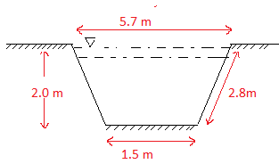
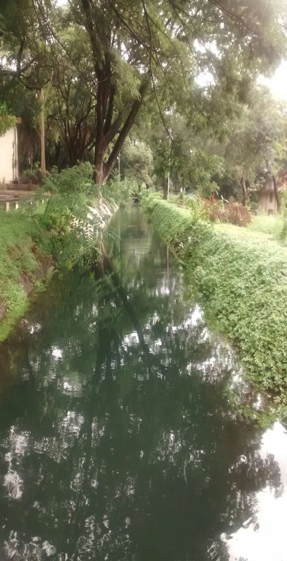
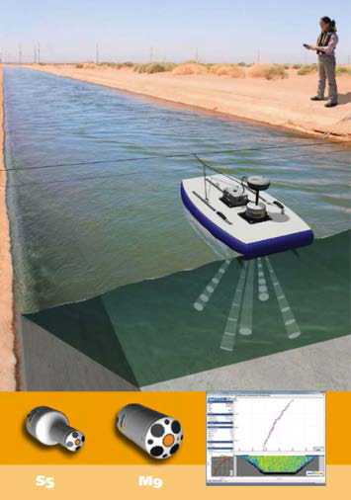
VELOCITY MEASUREMENT TRAINING
The Training Lab will be undertaken in channels of water conductor system at CWPRS

Slide 42
THEORY CLASSES
Various techniques of the water velocity measurement system such as propeller/ cup type current meters, ADCP, ADVM etc. would be discussed
Connection diagram
Sensor installation
Sensor configuration
Procedure of data collection & Transmission
This course will cover System start up ; connecting each ADCP type to data logger, connecting GPS via a Bluetooth or serial connection.
Data analysis methods
Maintenance of ADCP

Slide 43
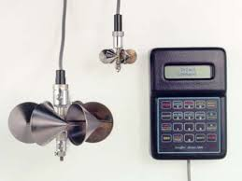
MECHANICAL CURRENT METERS

Slide 44
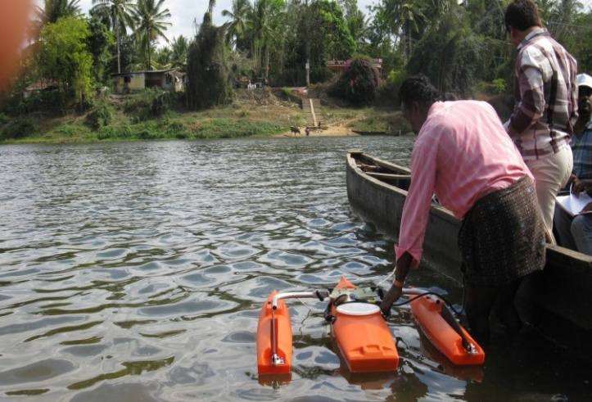
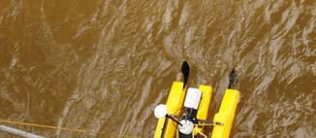
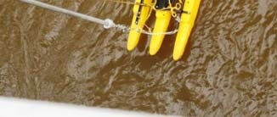
ACOUSTIC DOPPLER CURRENT PROFILER
Transducer assembly (4 transducers that operate at a fixed, ultrasonic frequency, typically 300, 600,or 1200 kHz with convex or concave configuration)
Pressure case ( instrument electronics)
Power cable
Portable microcomputer (laptop)
Moving boat (manned boats, tethered boats or Remotely controlled boat)

Slide 45
OUTCOME OF THE TRAINING
Understand the water velocity measurement techniques
Basic principles of Current meters and ADCP operation
Use of acoustic Doppler velocity meters (ADVM's)
Site selection, instrument installation and configuration considerations
Data collection procedures
Data processing and review (software training)
Troubleshooting problems encountered in the field
Practical aspects of using ADCP's for water velocity measurements

